Slide 1
Travel planner agent
IBM AICTE PROJECT
Presented By:DIBYASHREE DAS
Student name :DIBYASHREE DAS
College Name & Department : RCC Institute Of Information Technology,Electronics and Communication Engineering

Slide 2
OUTLINE
Problem Statement
Technology used
Wow factor
End users
Result
Conclusion
Git-hub Link
Future scope
IBM Certifications

Slide 3
Problem Statement
- A Travel Planner Agent is an AI-powered assistant that helps users plan trips efficiently and intelligently. It uses real-time data to suggest destinations, build itineraries, and recommend transport and accommodation options. By understanding user preferences, budgets, and constraints, it tailors personalized travel plans. Integrated with maps, weather updates, and local guides, it ensures a smooth travel experience. The agent can also manage bookings, alert users to changes, and optimize schedules on the go. This smart assistant transforms complex travel planning into a seamless, enjoyable process.

Slide 4
Technology used
IBM cloud lite services
Natural Language Processing (NLP)
Retrieval Augmented Generation (RAG)
IBM Granite model

Slide 5
IBM cloud services used
IBM Cloud Watsonx AI Studio
IBM Cloud Watsonx AI runtime
IBM Cloud Agent Lab
IBM Granite foundation model

Slide 6
Wow factors
This tool is designed to streamline the research process by saving time, enhancing literature review quality, guiding early-stage researchers, and promoting cross-disciplinary collaboration. It achieves this by making information more accessible and easier to apply.
Key Capabilities:
Advanced search using meaning-based (semantic) understanding of papers, journals, and datasets
Automatic generation of concise summaries for selected research articles
Tracking of citations and references to understand research impact
Personalized recommendations of research papers based on the user’s current area of study
Analysis of keyword or topic trends over time
Identification of potential collaborators or institutions with related research interests

Slide 7
End users
Academic Researchers
Research Institutions and Universities
Industry R&D Teams
Educators

Slide 8
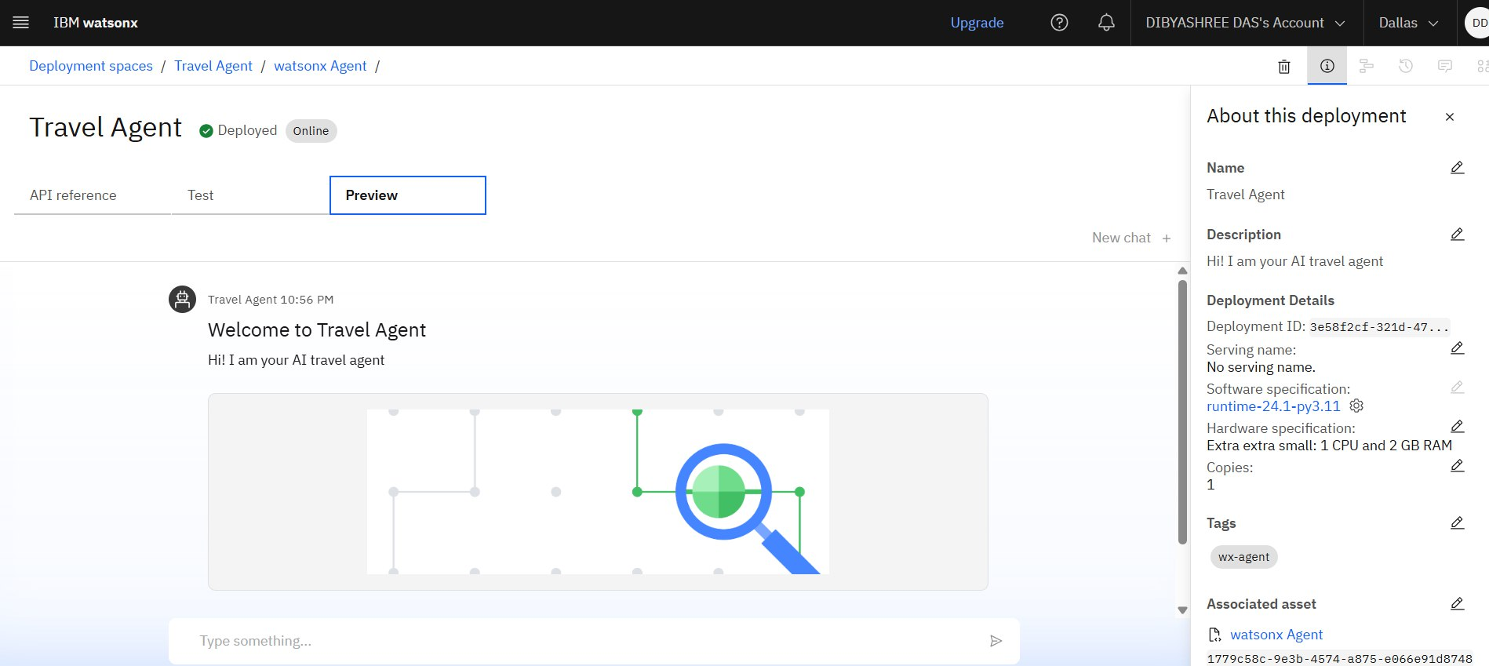
Results

Slide 9
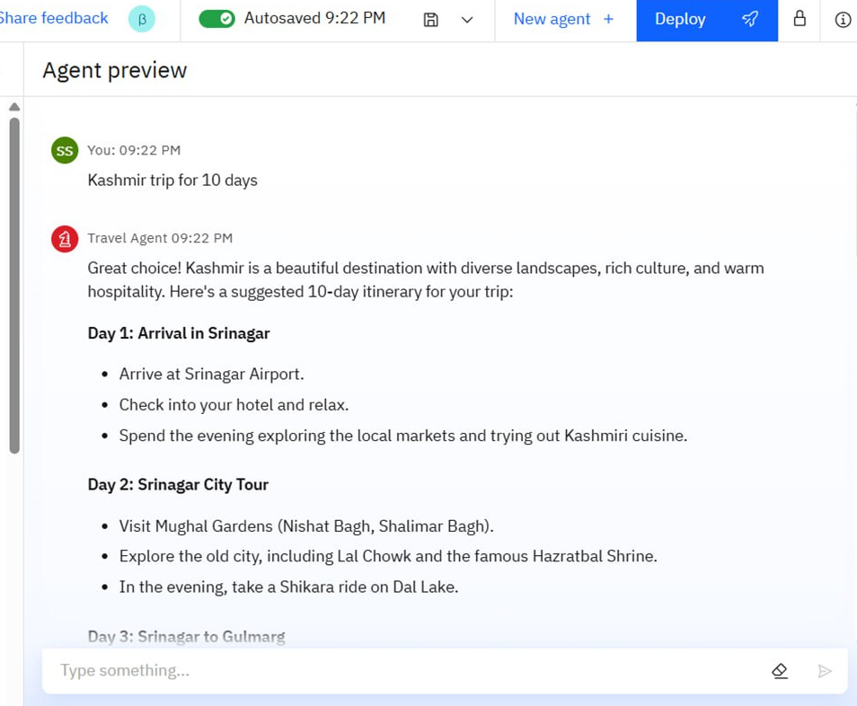
Results

Slide 10
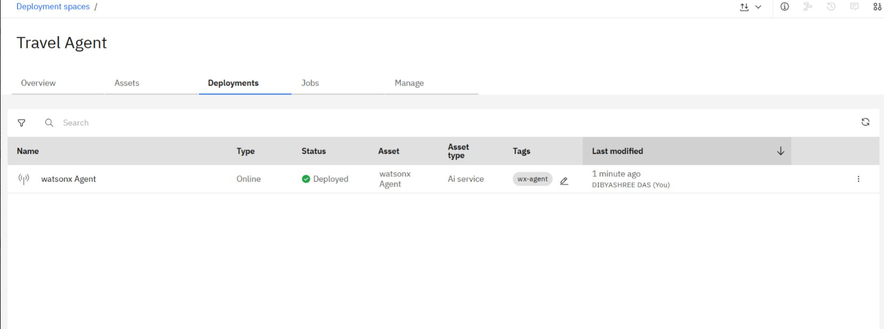
Results
Deployed AI Agent

Slide 11
Conclusion
The Travel AI Agent revolutionizes trip planning by delivering personalized, efficient, and intelligent travel experiences. By leveraging real-time data, user preferences, and advanced algorithms, it simplifies itinerary creation, optimizes travel routes, and provides tailored recommendations for accommodations, attractions, and local experiences. This agent not only saves time and effort but also enhances the overall travel experience—making exploration smarter, more enjoyable, and stress-free.

Slide 12
Future scope
Multilingual Research Support
Voice-Activated Research Assistant
Real-Time Collaboration Features
Research Gap and Novel Topic Identification
Integration with Publishing Platforms
AI-Assisted Paper Drafting

Slide 13
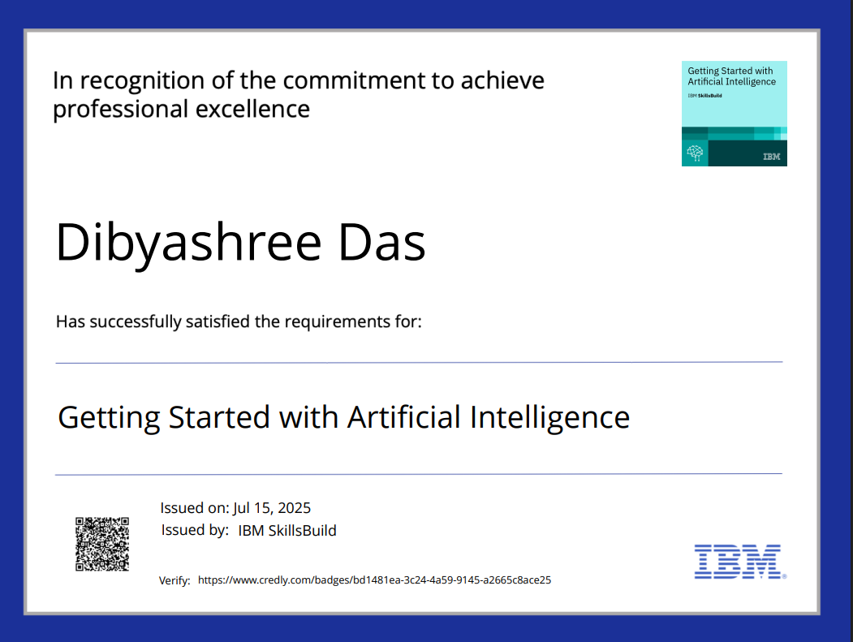
IBM Certifications
Screenshot/ credly certificate( getting started with AI)

Slide 14
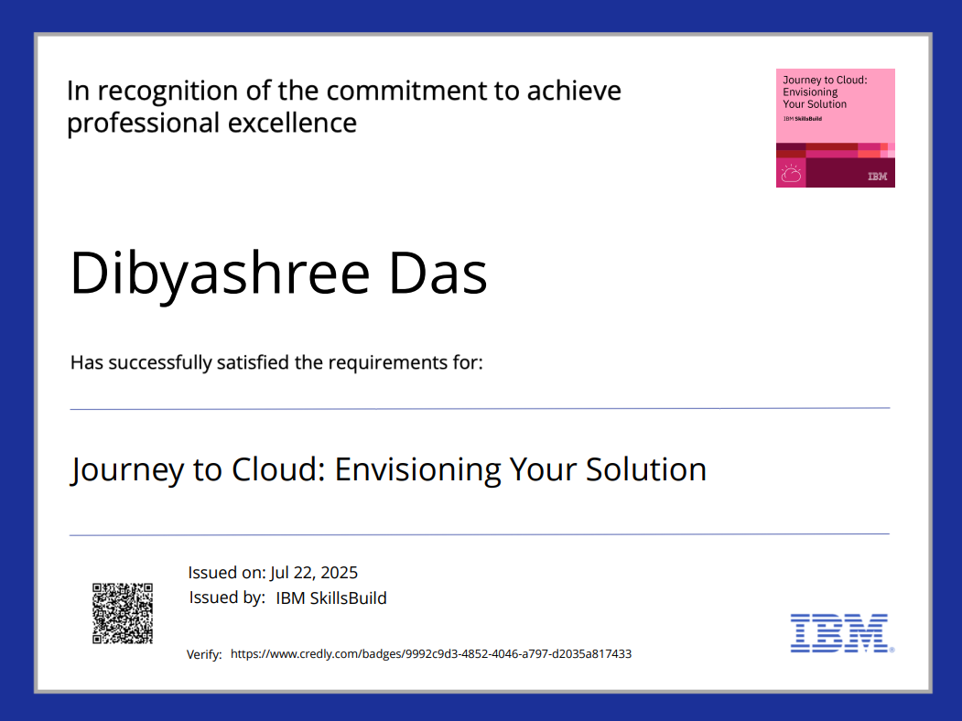
Screenshot/ credly certificate( Journey to cloud)

Slide 15
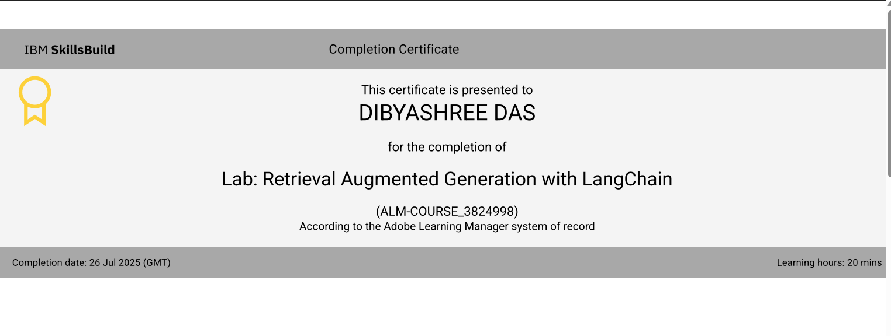
Attach your RAG LAB certificate here

Slide 16
Git hub link :

Slide 17
GitHub Link
Make sure that there should be readme file

Slide 18
THANK YOU

